Slide 1
ATAI
Advanced Technique of Artificial Intelligence
ATAI
ChongqingUniversity _{AdvancedTechniqueof}
of Technology Artificial Intelligence
Chongqing University of Technology
Chongqing University ^{ATAI}
_{of Technology} Advanced Techniqueof
Artificial Intelligence
Chongqing University of Technology
Chongqing University of Technology
Revisiting Multimodal Representation in Contrastive Learning: From Patch and Token Embeddings to Finite Discrete Tokens
Code:https : / / github . com / yuxiaochen1103/FDT.
—— CVPR ’23
Reported by Shu Ming Jiang
1

Slide 2
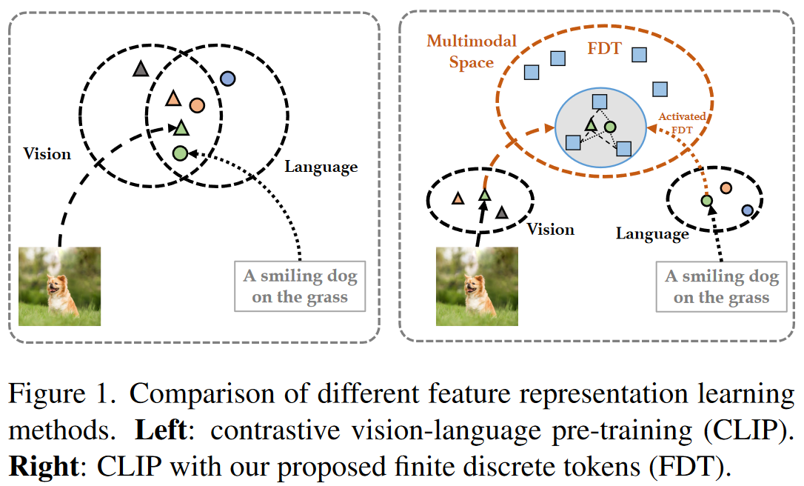
ATAI
Advanced Technique of
Artificial Intelligence
ATAI
ChongqingUniversity _{AdvancedTechniqueof}
of Technology Artificial Intelligence
Chongqing University of Technology
Introduction
(1)the fact that the information conveyed in images and text captions is naturally of different levels of granularities is not considered by such models.

Slide 3
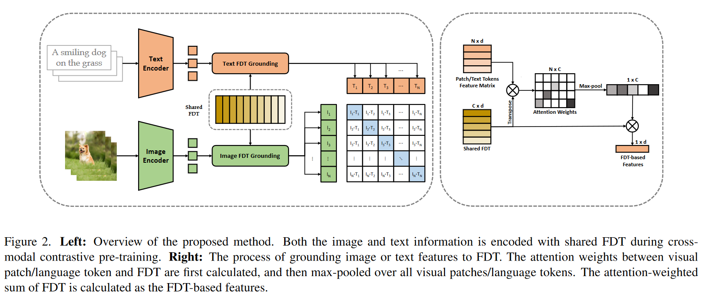
ATAI
Advanced Technique of
Artificial Intelligence
ATAI
ChongqingUniversity _{AdvancedTechniqueof}
of Technology Artificial Intelligence
Chongqing University of Technology
Overview

Slide 4
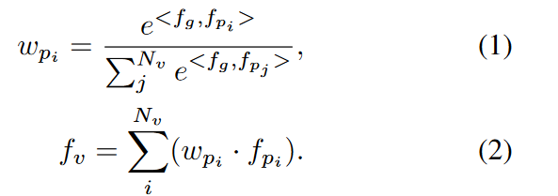
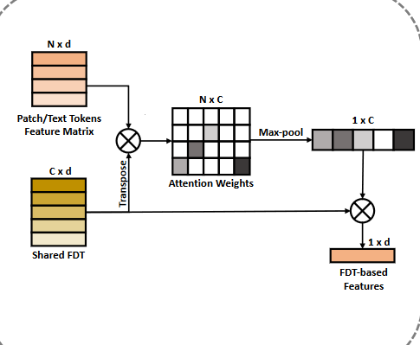
ATAI
Advanced Technique of
Artificial Intelligence
ATAI
ChongqingUniversity _{AdvancedTechniqueof}
of Technology Artificial Intelligence
Chongqing University of Technology
Method

Slide 5
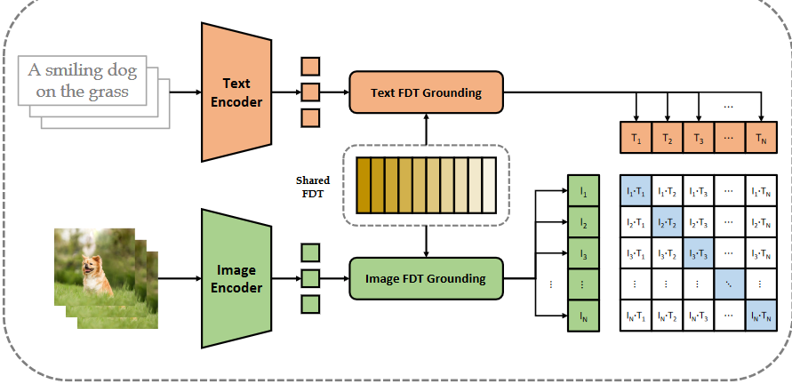
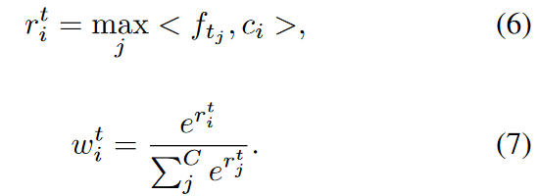
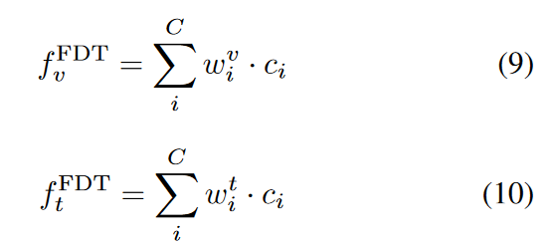
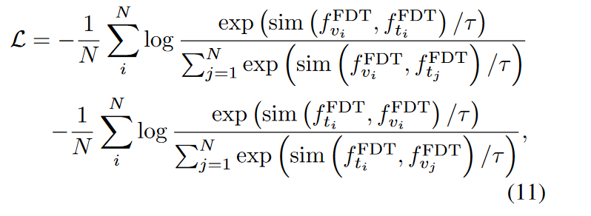
ATAI
Advanced Technique of
Artificial Intelligence
ATAI
ChongqingUniversity _{AdvancedTechniqueof}
of Technology Artificial Intelligence
Chongqing University of Technology
Method

Slide 6
ATAI
Advanced Technique of
Artificial Intelligence
ATAI
ChongqingUniversity _{AdvancedTechniqueof}
of Technology Artificial Intelligence
Chongqing University of Technology
Experiments

Slide 7
ATAI
Advanced Technique of
Artificial Intelligence
ATAI
ChongqingUniversity _{AdvancedTechniqueof}
of Technology Artificial Intelligence
Chongqing University of Technology
Experiments

Slide 8
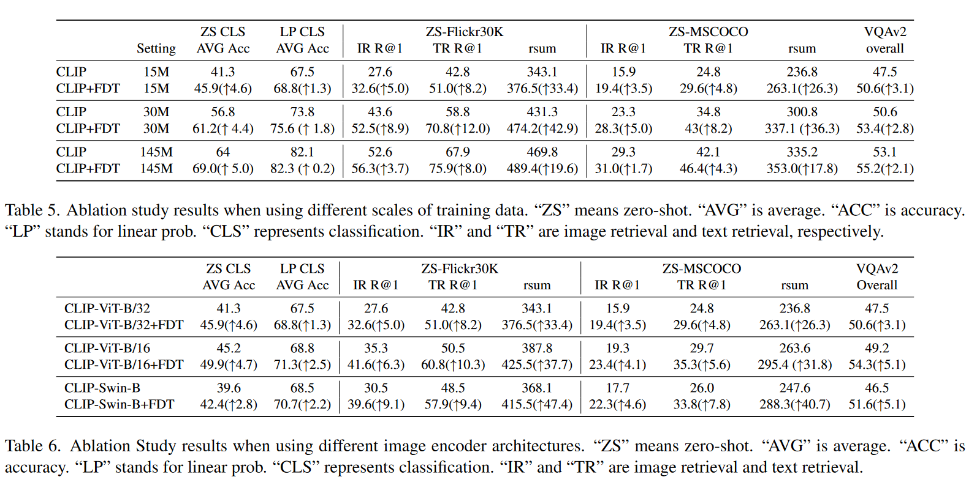
ATAI
Advanced Technique of
Artificial Intelligence
ATAI
ChongqingUniversity _{AdvancedTechniqueof}
of Technology Artificial Intelligence
Chongqing University of Technology
Experiments

Slide 9
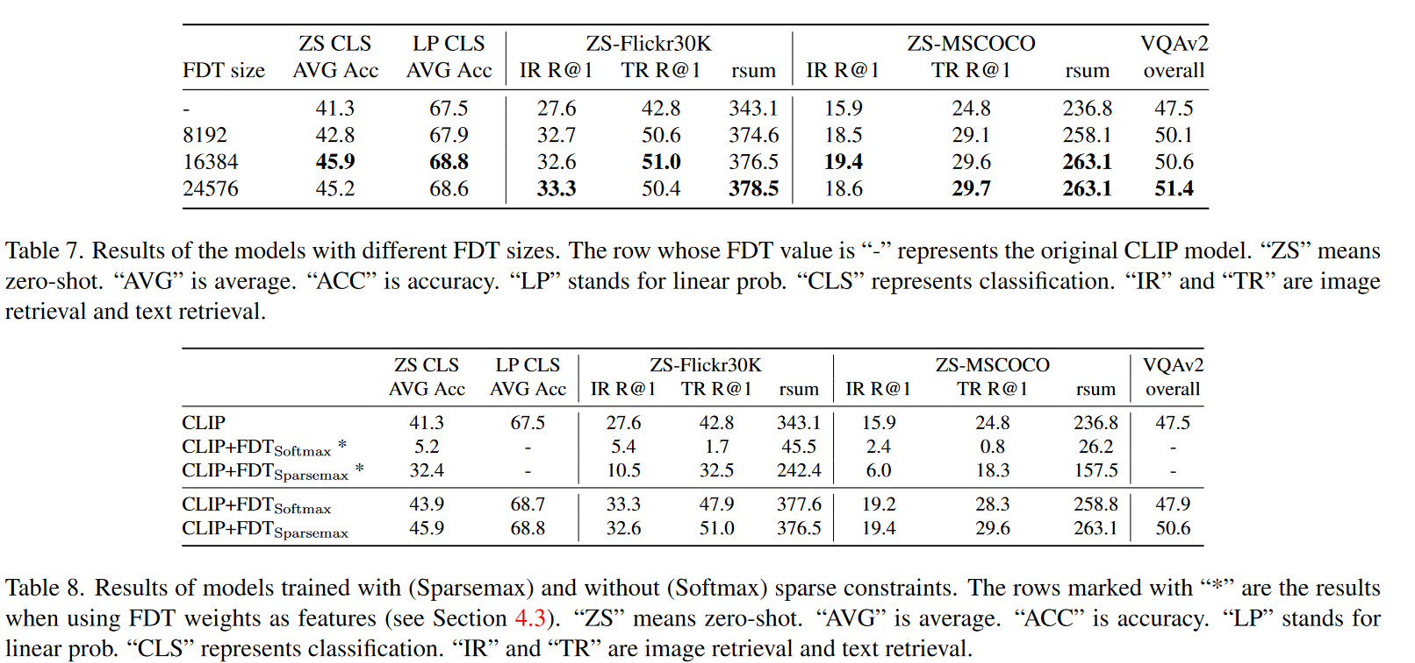
ATAI
Advanced Technique of
Artificial Intelligence
ATAI
ChongqingUniversity _{AdvancedTechniqueof}
of Technology Artificial Intelligence
Chongqing University of Technology
Experiments

Slide 10
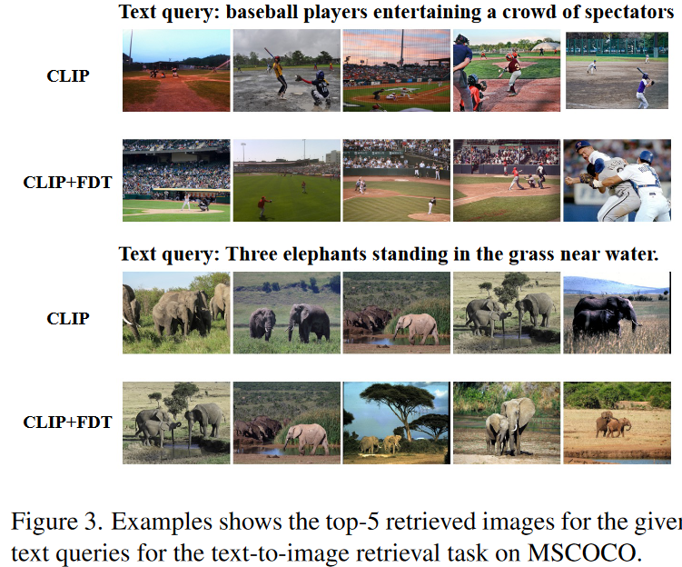
ATAI
Advanced Technique of
Artificial Intelligence
ATAI
ChongqingUniversity _{AdvancedTechniqueof}
of Technology Artificial Intelligence
Chongqing University of Technology
Experiments

Slide 11
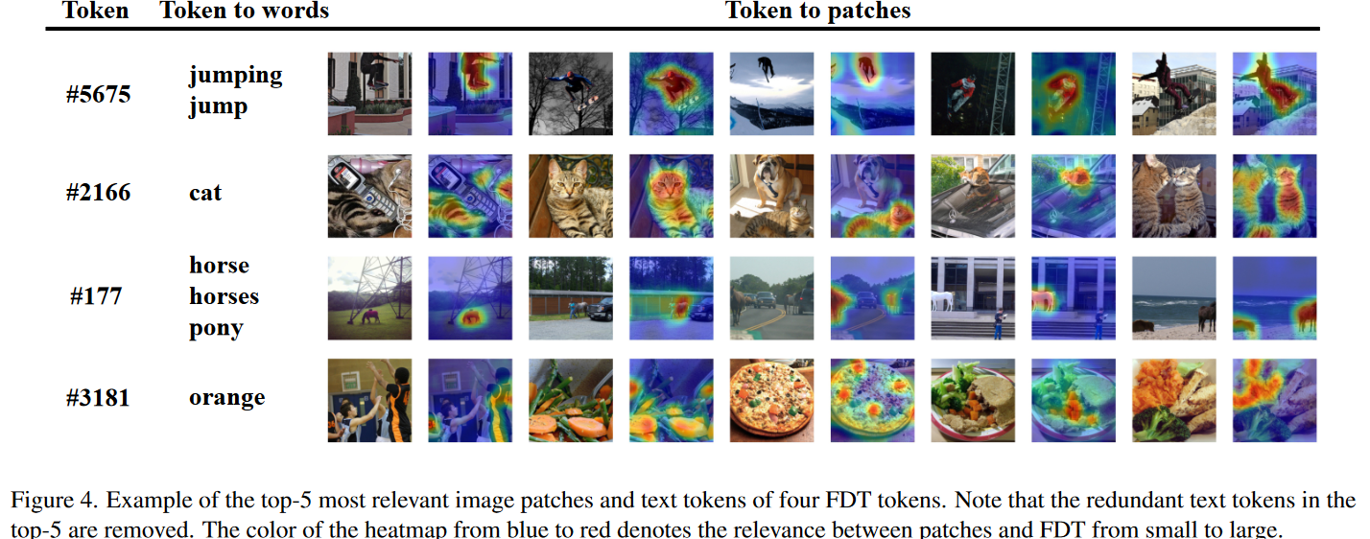
ATAI
Advanced Technique of
Artificial Intelligence
ATAI
ChongqingUniversity _{AdvancedTechniqueof}
of Technology Artificial Intelligence
Chongqing University of Technology
Experiments

Slide 12
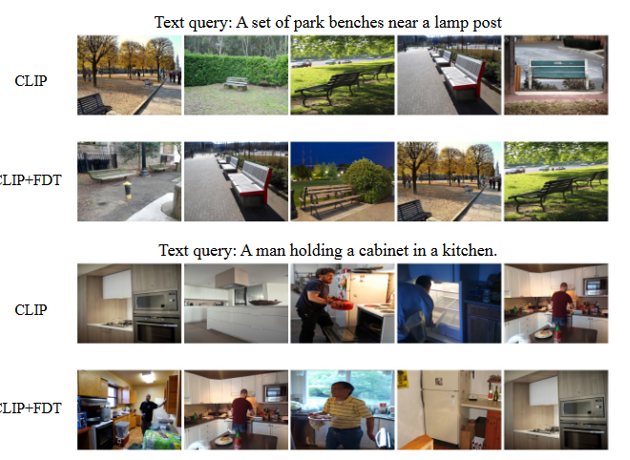
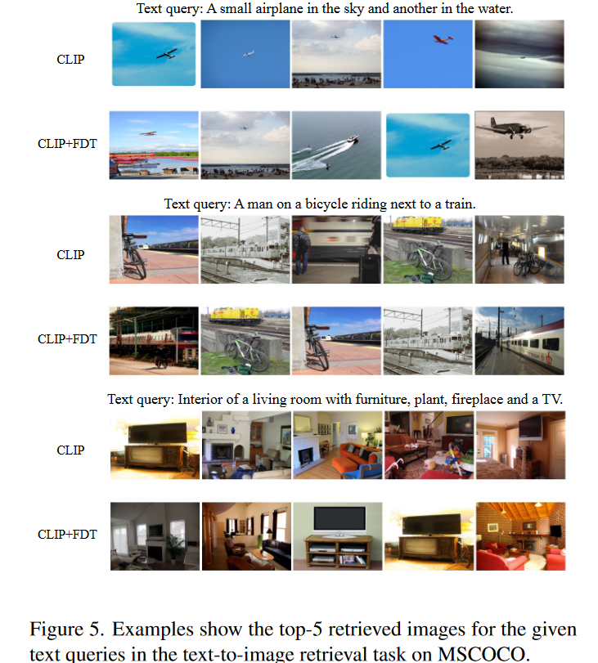
ATAI
Advanced Technique of
Artificial Intelligence
ATAI
ChongqingUniversity _{AdvancedTechniqueof}
of Technology Artificial Intelligence
Chongqing University of Technology
Experiments

Slide 13
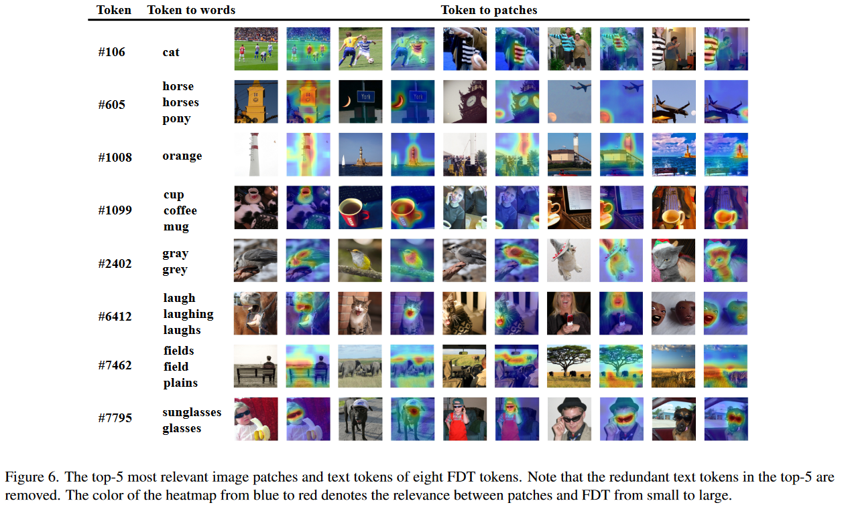
ATAI
Advanced Technique of
Artificial Intelligence
ATAI
ChongqingUniversity _{AdvancedTechniqueof}
of Technology Artificial Intelligence
Chongqing University of Technology
Experiments

Slide 14
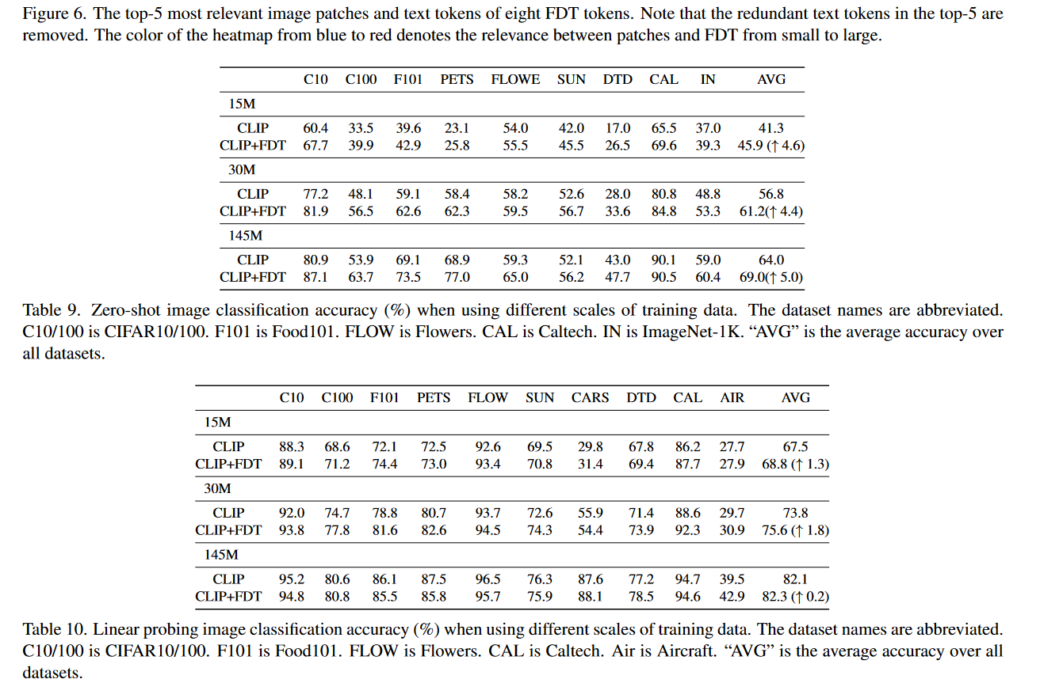
ATAI
Advanced Technique of
Artificial Intelligence
ATAI
ChongqingUniversity _{AdvancedTechniqueof}
of Technology Artificial Intelligence
Chongqing University of Technology
Experiments

Slide 15
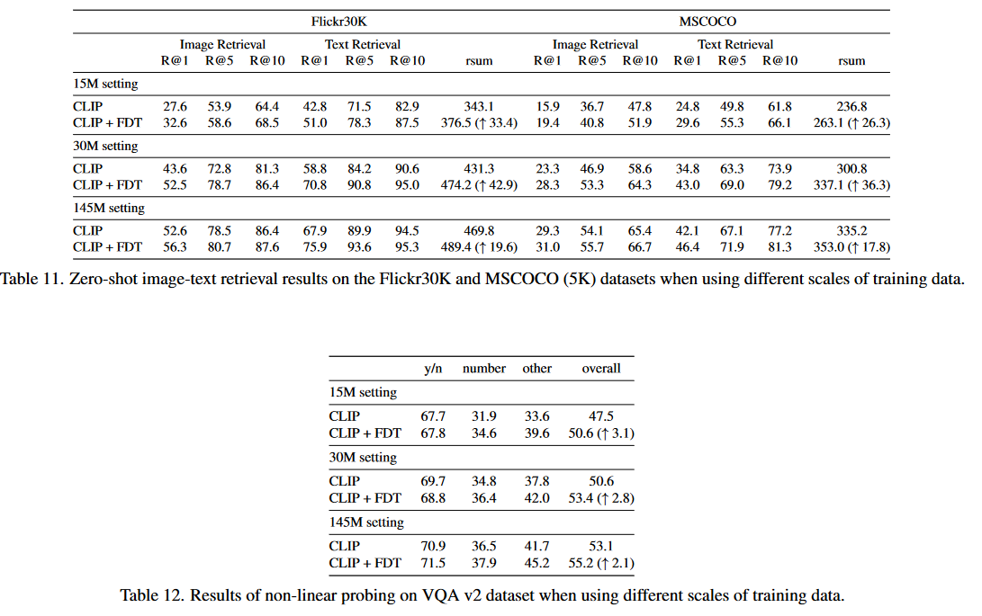
ATAI
Advanced Technique of
Artificial Intelligence
ATAI
ChongqingUniversity _{AdvancedTechniqueof}
of Technology Artificial Intelligence
Chongqing University of Technology
Experiments

Slide 16
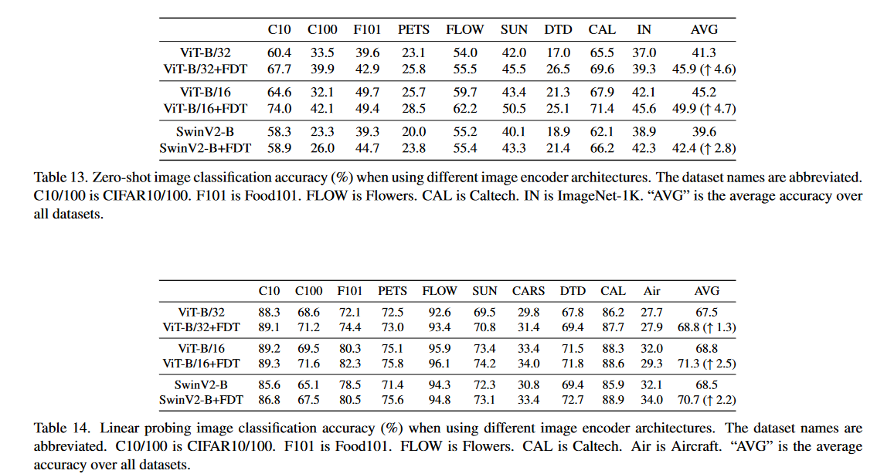
ATAI
Advanced Technique of
Artificial Intelligence
ATAI
ChongqingUniversity _{AdvancedTechniqueof}
of Technology Artificial Intelligence
Chongqing University of Technology
Experiments

Slide 17
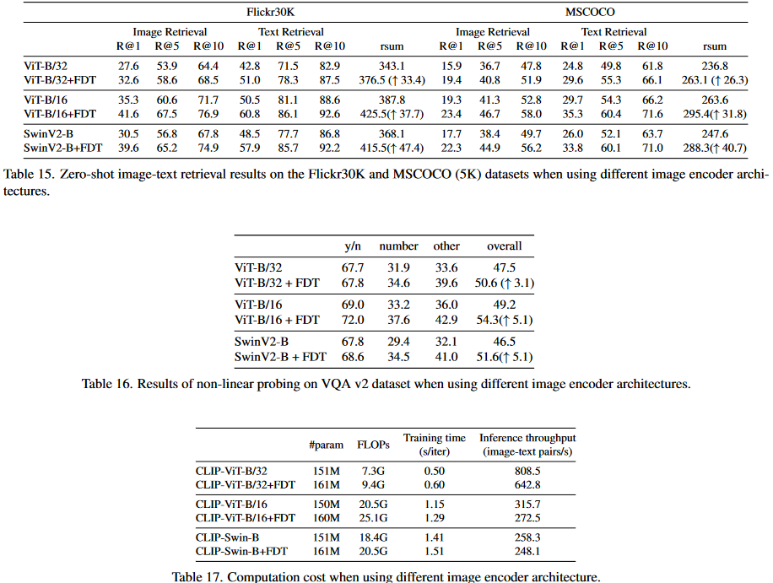
ATAI
Advanced Technique of
Artificial Intelligence
ATAI
ChongqingUniversity _{AdvancedTechniqueof}
of Technology Artificial Intelligence
Chongqing University of Technology
Experiments

Slide 18
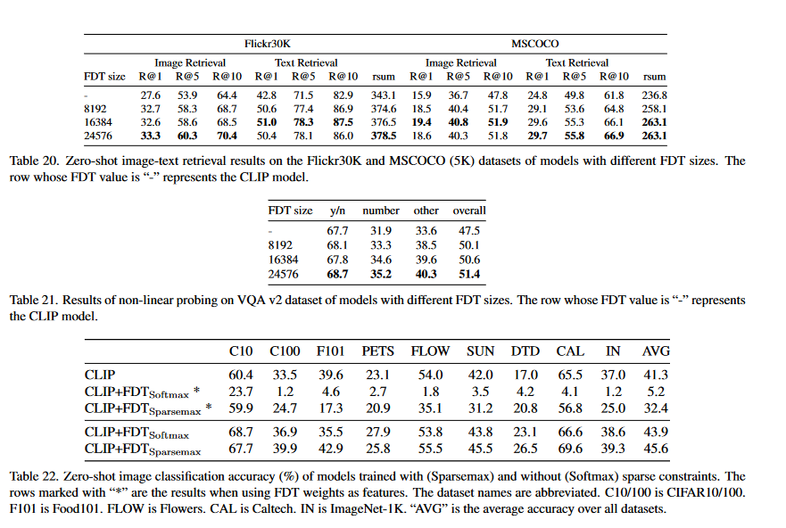
ATAI
Advanced Technique of
Artificial Intelligence
ATAI
ChongqingUniversity _{AdvancedTechniqueof}
of Technology Artificial Intelligence
Chongqing University of Technology
Experiments

Slide 19
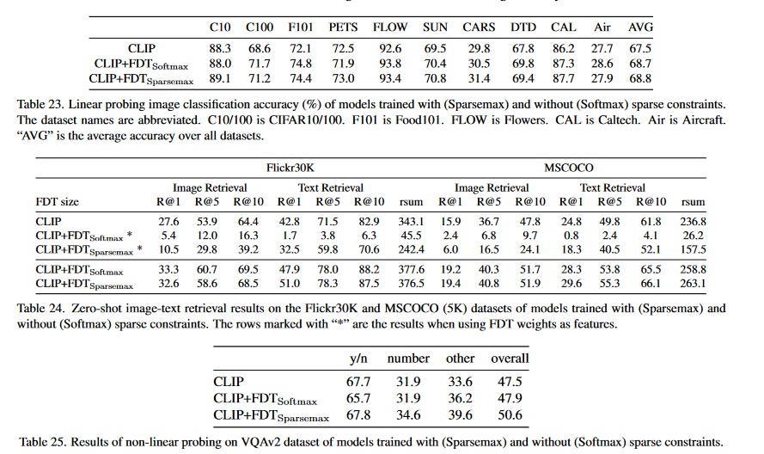
ATAI
Advanced Technique of
Artificial Intelligence
ATAI
ChongqingUniversity _{AdvancedTechniqueof}
of Technology Artificial Intelligence
Chongqing University of Technology
Experiments

Slide 20
ChongqingUniversity of Technology
ATAI
Advanced Technique of
Artificial Intelligence
ATAI
ChongqingUniversity _{AdvancedTechniqueof}
of Technology Artificial Intelligence
Chongqing University of Technology
Thanks!

